Slide 1
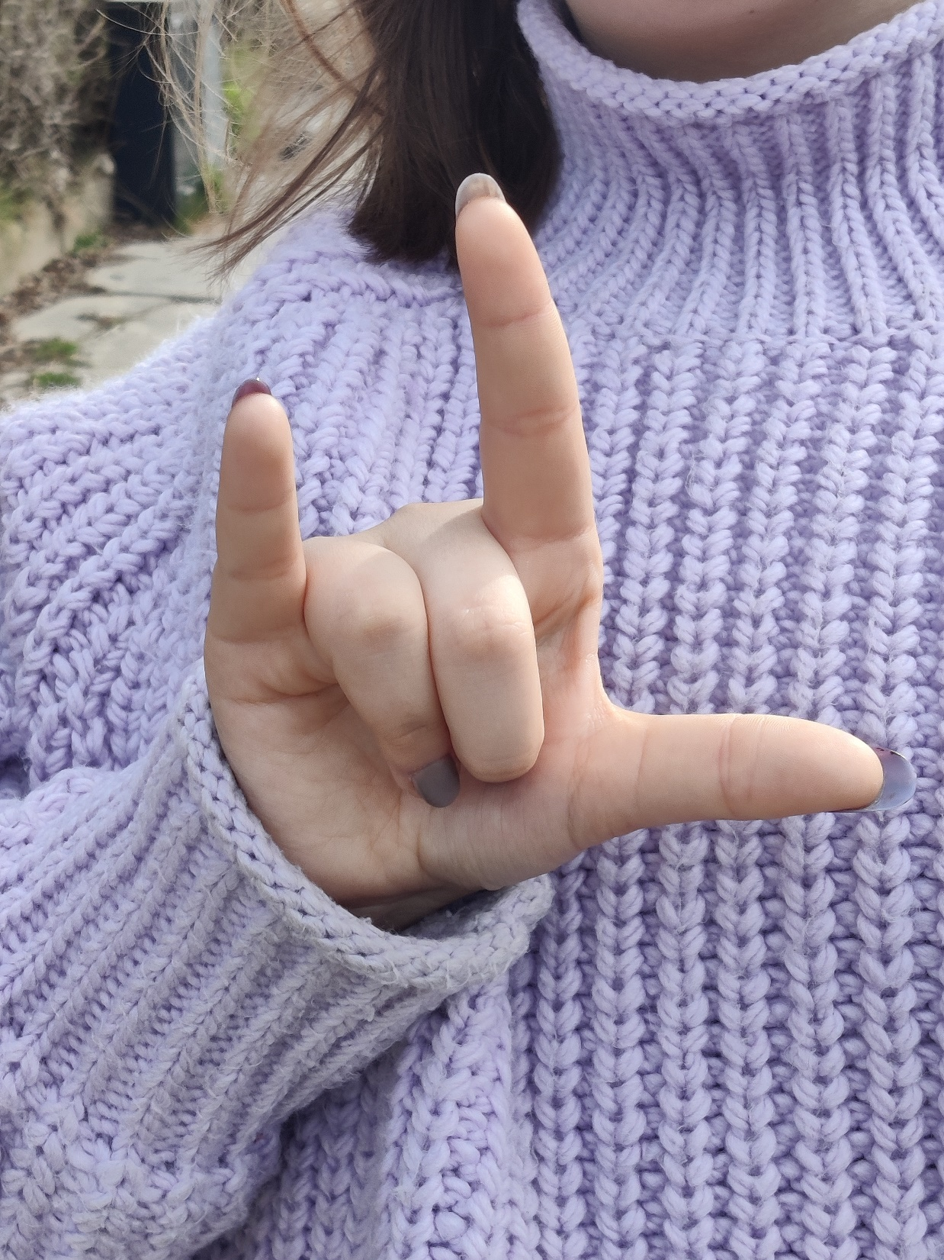
Freds Salme
ML Winther 2008 inspireret af tysk døvekor

Slide 2
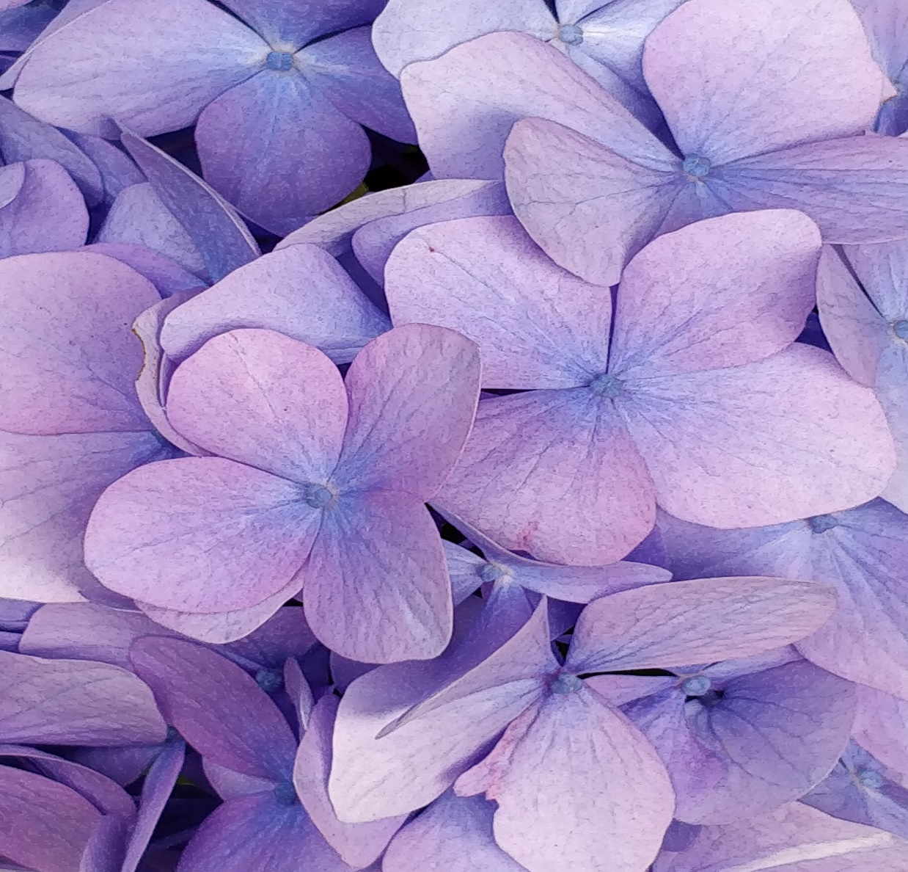
FRED – FRED GIVE – GIVE FRED – FRED GIVE – GIVE GOD – GOD DAG – DAG GOD – GOD DAG - DAG FRED – FRED GIVE – GIVE FRED – FRED GIVE - GIVE

Slide 3
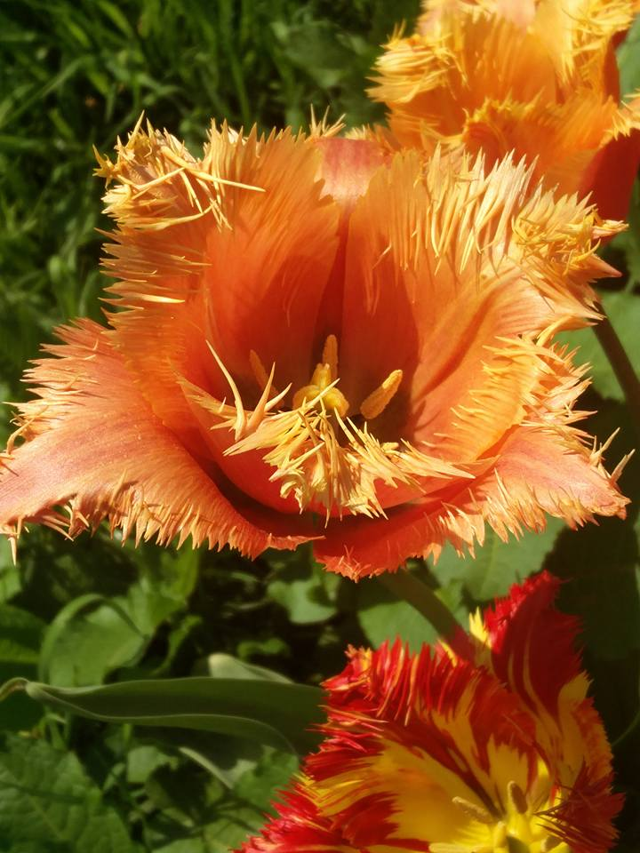
FRED – FRED GIVE – GIVE FRED – FRED GIVE – GIVE VI SES – VI SES BI-BI BI-BI VI SES – VI SES BI-BI BI-BI FRED – FRED GIVE – GIVE FRED – FRED GIVE - GIVE

